Slide 1

Example Problems
MTCS101/U-II

Slide 2
Q. How many two state DFAs with a designated initial state and a designated final state can be constructed over the alphabet = {a,b}
MTCS101/U-II

Slide 3
Q. How many two state DFAs with a designated initial state and a designated final state can be constructed over the alphabet = {a,b}
MTCS101/U-II

Slide 4
MTCS101/U-II
Design a FA with ∑ = {0, 1} accepts those string which starts with 1 and ends with 0.

Slide 5
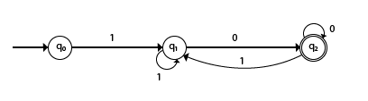
MTCS101/U-II
Design a FA with ∑ = {0, 1} accepts those string which starts with 1 and ends with 0.

Slide 6
MTCS101/U-II
Design a FA with ∑ = {0, 1} accepts the only input 101.

Slide 7

MTCS101/U-II
Design a FA with ∑ = {0, 1} accepts the only input 101.

Slide 8
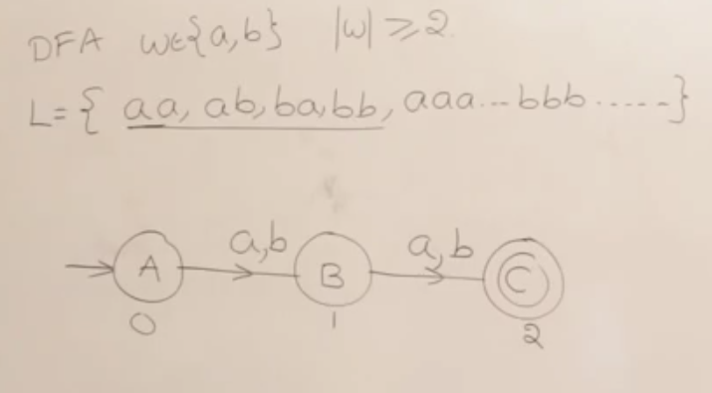
MTCS101/U-II
??

Slide 9
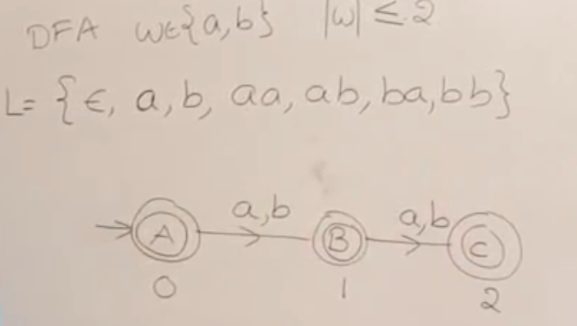
MTCS101/U-II
??

Slide 10
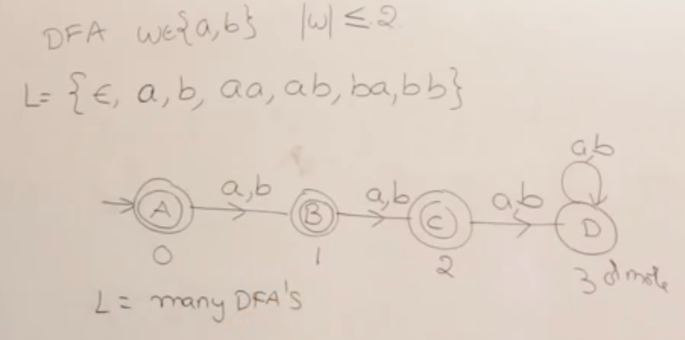
MTCS101/U-II

Slide 11
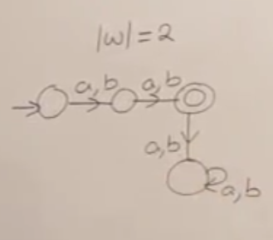
MTCS101/U-II

Slide 12
MTCS101/U-II
Design FA with ∑ = {0, 1} accepts even number of 0's and even number of 1's.

Slide 13
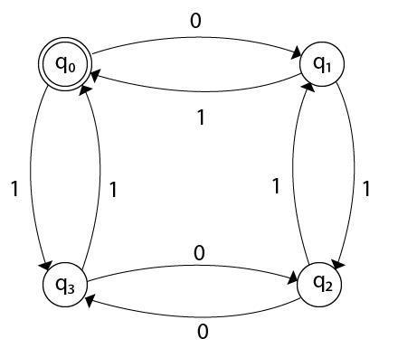
MTCS101/U-II
Design FA with ∑ = {0, 1} accepts even number of 0's and even number of 1's.

Slide 14
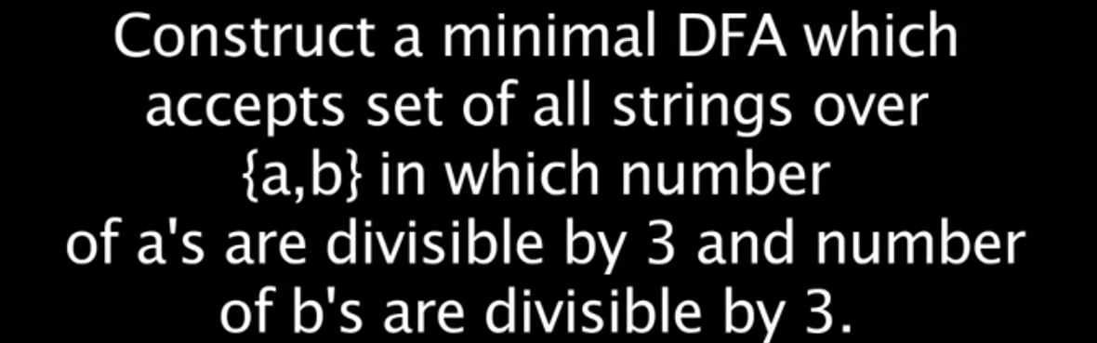
MTCS101/U-II

Slide 15
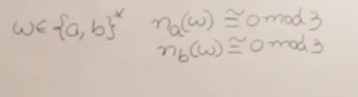
MTCS101/U-II

Slide 16
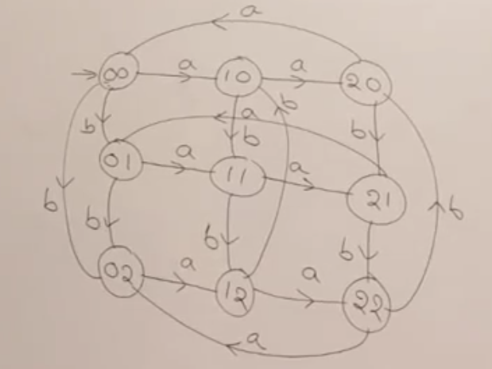
MTCS101/U-II

Slide 17
MTCS101/U-II
Design a DFA L(M) = {w | w ε {0, 1}*} and W is a string that does not contain consecutive 1's.

Slide 18
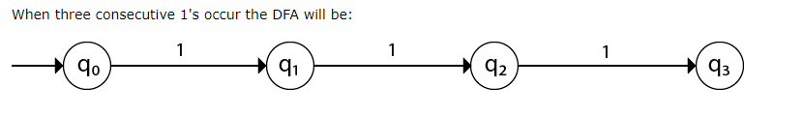
MTCS101/U-II
Design a DFA L(M) = {w | w ε {0, 1}*} and W is a string that does not contain consecutive 1's.

Slide 19
MTCS101/U-II
Complement of a DFA
String accepted in previous DFA will not be accepted and non accepting string will be accepted .
If (Q, ∑, δ, q₀, F) be a DFA that accepts a language L, then the complement of the DFA can be obtained by swapping its accepting states with its non-accepting states and vice versa.

Slide 20
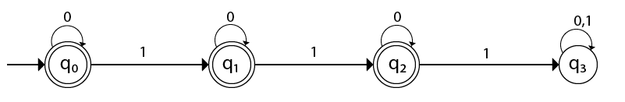
MTCS101/U-II
Design a DFA L(M) = {w | w ε {0, 1}*} and W is a string that does not contain consecutive 1's.

